Slide 1
3.3 CONCURRENCY CONTROL WITH LOCKING METHODS
Module III

Slide 2
Lock guarantees exclusive use of data item to current transaction.
Transaction T2 does not have access to a data item that is currently used by transaction T1.
A transaction acquires a lock prior to data access.
The lock is released (unlocked) when the transaction is complete so that another transaction can lock the data item for its exclusive use.

Slide 3
The use of locks is based on the assumption that conflict between transactions is likely and is known as pessimistic locking.
Data consistency cannot be guaranteed during a transaction, the database may be in a temporary inconsistent state when several updates are executed.

Slide 4
Locks are required to prevent another transaction from reading inconsistent data.
Multi-user DBMSs automatically initiate and enforce locking procedures.
All lock information is managed by a lock manager, which is responsible for assigning and policing the locks used by the transactions.

Slide 5
i. Lock Granularity
Lock granularity indicates the level of lock use. Locking can take place at the following levels:
    Database level
    Table level
    Page level
    Row level
    Field level(attribute).

Slide 6
Database Level
The entire database is locked, thus preventing the use of any tables in the database by transaction T2 while transaction T1 is being executed.
This level of locking is good for batch processes, but it is unsuitable for online multi-user DBMSs.

Slide 7
The data access would be slow if thousands of transactions had to wait for the previous transaction to be completed before the next one could reserve the entire database.
Transactions T1 and T2 cannot access the same database concurrently even when they use different tables.

Slide 8
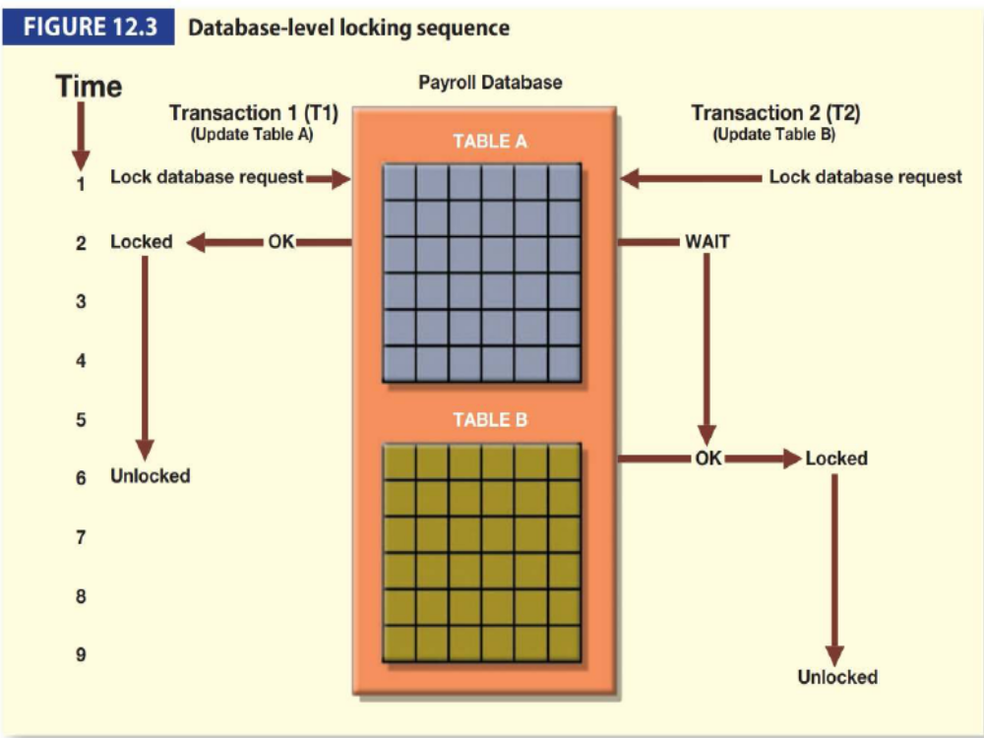

Slide 9
Table Level
Entire table is locked
Prevent access to any row by transaction T2 while transaction T1 is using the table.
If a transaction requires access to several tables, each table may be locked.
Two transactions can access the same database as long as they access different tables.

Slide 10
It cause traffic jams when many transactions are waiting to access the same table.
Table-level locks are not suitable for multi-user DBMS.
Transactions T1 and T2 cannot access the same table even when they try to use different rows; T2 must wait until T1 unlocks the table.

Slide 11
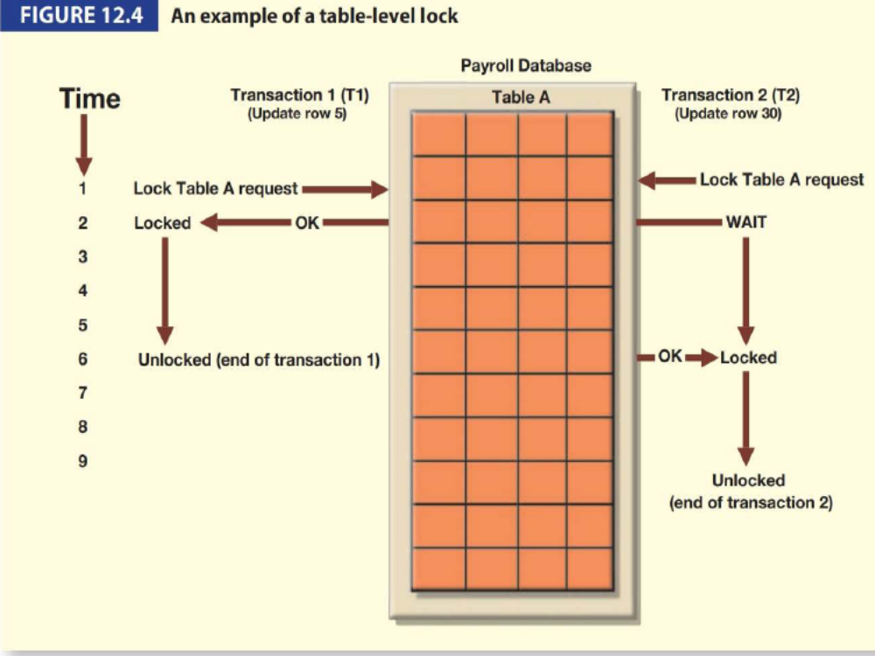

Slide 12
Page Level
DBMS locks an entire disk page.
A disk page, or page, is the equivalent of a disk block, which can be described as a directly addressable section of a disk.
A page has a fixed size, such as 4K, 8K or 16K.

Slide 13
To write only 73 bytes to a 4K page, the entire 4K page must be read from disk, updated in memory and written back to disk.
A table can span several pages, and a page can contain several rows of one or more tables

Slide 14
Frequently used multiuser DBMS locking method.
T1 and T2 access the same table while locking different disk pages.
If T2 requires the use of a row located on a page that is locked by T1, T2 must wait until the page is unlocked by T1.

Slide 15
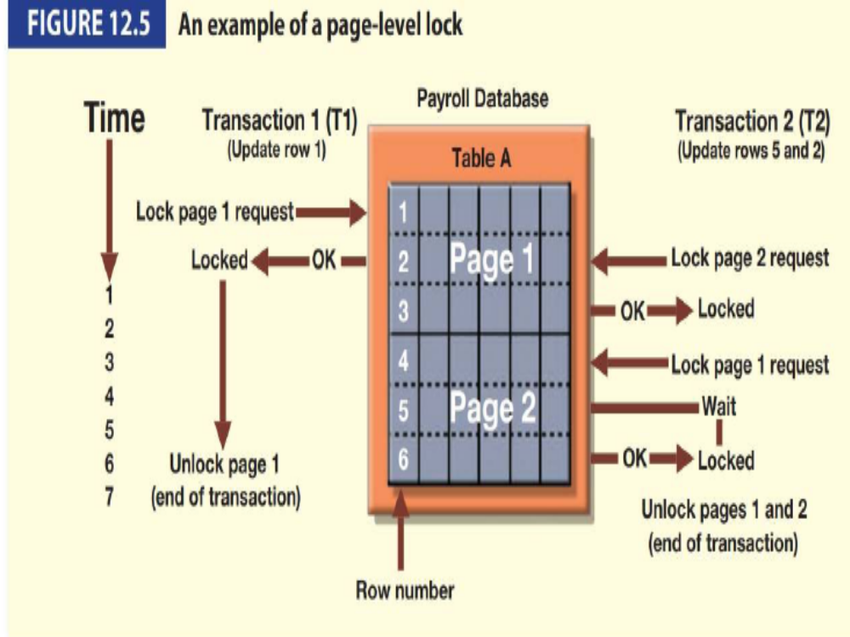

Slide 16
Row Level
The DBMS allows concurrent transactions to access different rows of the same table, even when the rows are located on the same page.
Although the row-level locking approach improves the availability of data, its management requires high overhead.
A lock exists for each row in each table of the database.

Slide 17
Both transactions can execute concurrently, even when the requested rows are on the same page.
T2 must wait only if it requests the same row as T1.

Slide 18
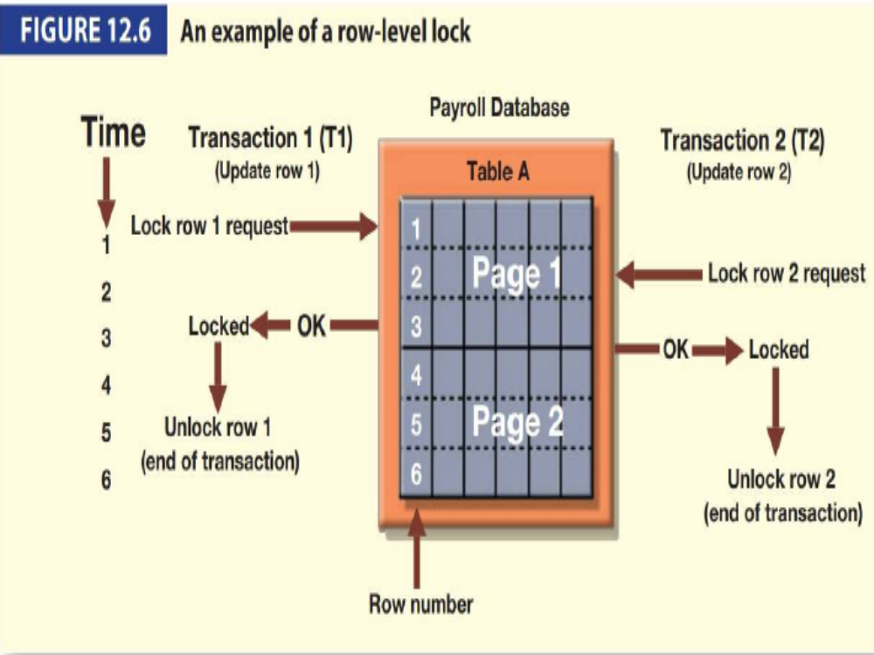

Slide 19
Field Level
The field-level lock allows concurrent transactions to access the same row as long as they require the use of different fields(attributes) within that row.
Although field-level locking clearly yields the most flexible multi-user data access, it is rarely done because it requires an extremely high level of computer overhead.

Slide 20
ii. Lock Types
The DBMS use different lock types:
    Binary
    Shared/exclusive.
Binary Locks
It has only two states:
    locked (1)
    unlocked (0).

Slide 21
If an object that is, a database, table, page or row is locked by a transaction, no other transaction can use that object.
If an object is unlocked, any transaction can lock the object for its use.
A transaction must unlock the object after its termination.
Every transaction requires a lock and unlock operation for each data item that is accessed.

Slide 22
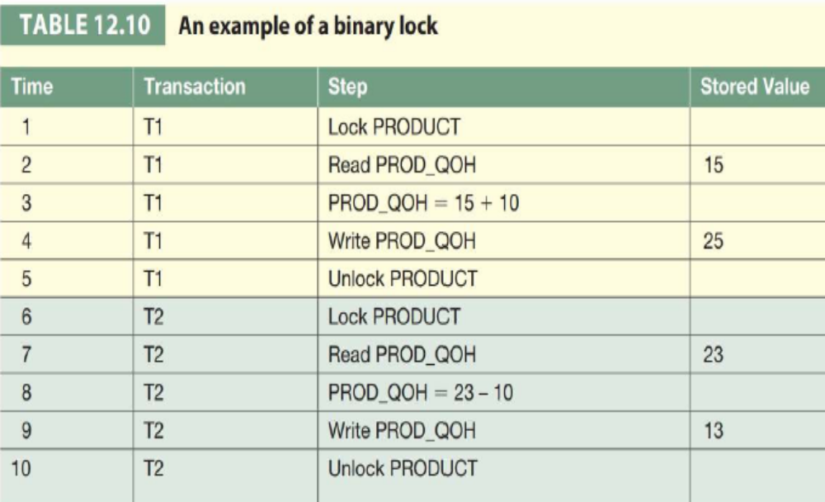
Such operations are automatically managed and scheduled by the DBMS.

Slide 23
The lock and unlock features eliminate the lost update problem.
The lock is not released until the write statement is completed. Therefore a PROD_QOH value cannot be used until it has been properly updated.
The DBMS will not allow two transactions to read the same database object even though neither transaction updates the database.
Concurrency conflicts occur only when two transactions execute concurrently and one of them updates the database.

Slide 24
Shared/Exclusive Locks
 | Exclusive Lock | Shared Lock
1. | Exists when access is reserved specifically for the transaction that locked the object. | Exists when concurrent transactions are granted Read access on the basis of a common lock
2. | Used when conflict occurs | Produces no conflict
3. | Issued when a transaction wants to update (write) a data item and no locks are currently held on that data item by any other transaction. | Issued when a transaction wants to read data from the database and no exclusive lock is held on that data item.

Slide 25
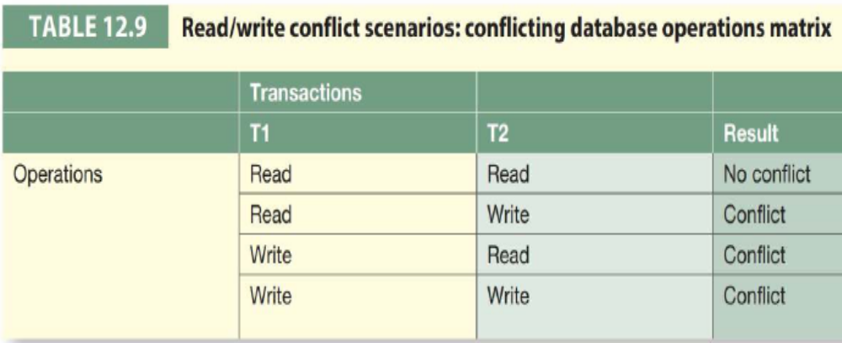
Two transactions conflict only when at least one of them is a Write transaction.
The two Read transactions can be safely executed at once, shared locks allow several Read transactions to read the same data item concurrently.

Slide 26
If transaction T1 has a shared lock on data item X and transaction T2 wants to read data item X, T2 may also obtain a shared lock on data item X.
If transaction T2 updates data item X, an exclusive lock is required by T2 over data item X.
The exclusive lock is granted if and only if no other locks are held on the data item.
This condition is known as the mutually exclusive rule: only one transaction at a time can own an exclusive lock on the same object.

Slide 27
Although the possibility of shared locks renders data access more efficient, a shared/exclusive lock schema increases the lock managers overhead, for several reasons:
  The type of lock held must be known before a lock can be granted.
  Three lock operations exist: READ_LOCK (to check the type of lock), WRITE_LOCK (to issue the lock) and UNLOCK (to release the lock).
  The schema has been enhanced to allow a lock upgrade (from shared to exclusive) and a lock downgrade (from exclusive to shared).

Slide 28
Although locks prevent serious data inconsistencies, they can lead to two major problems:
  The resulting transaction schedule may not be serialisable.
  The schedule may create deadlocks. A database deadlock, which is equivalent to traffic gridlock in a big city, is caused when two transactions wait for each other to unlock data

Slide 29
Both problems can be managed: serialisability is guaranteed through a locking protocol known as two-phase locking, and deadlocks can be managed using deadlock detection and prevention techniques.

Slide 30
iii. Two-Phase Locking to Ensure Serialisability
Two-phase locking defines how transactions acquire and relinquish locks.
Two-phase locking guarantees serialisability, but it does not prevent deadlocks.

Slide 31
The two phases are:
  A growing phase, in which a transaction acquires all required locks without unlocking any data. Once all locks have been acquired, the transaction is in its locked point.
  A shrinking phase, in which a transaction releases alllocks and cannot obtain any new lock.

Slide 32
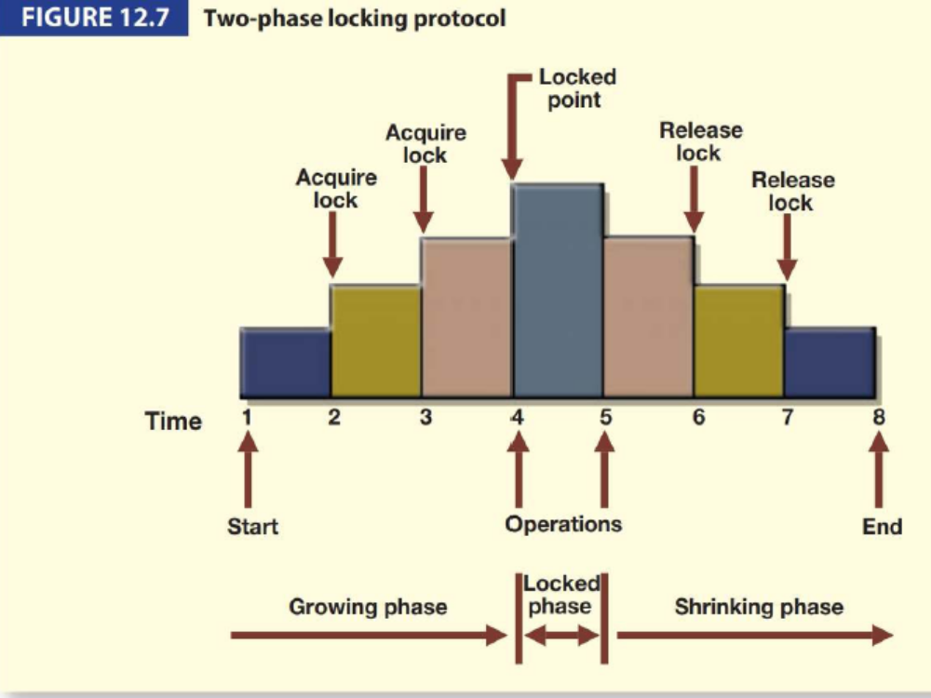

Slide 33
In this example, the transaction acquires all of the locks it needs until it reaches its locked point. (The transaction requires two locks.)
When the locked point is reached, the data are modified to conform to the transaction requirements.
Finally, the transaction is completed as it releases all of the locks it acquired in the first phase.

Slide 34
Two-phase locking increases the transaction processing cost and may cause additional undesirable effects.
One undesirable effect is the possibility of creating deadlocks.

Slide 35
iv. Deadlocks
A deadlock occurs when two transactions wait for each other to unlock data.
For example, a deadlock occurs when two transactions, T1 and T2, exist in the following mode:
    T1 = access data items X and Y
    T2 = access data items Y and X

Slide 36
If T1 has not unlocked data item Y, T2 cannot begin.
If T2 has not unlocked data item X, T1 cannot continue.
Consequently, T1 and T2 wait indefinitely, each waiting for the other to unlock the required data item. Such a deadlock is also known as a deadly embrace.

Slide 37
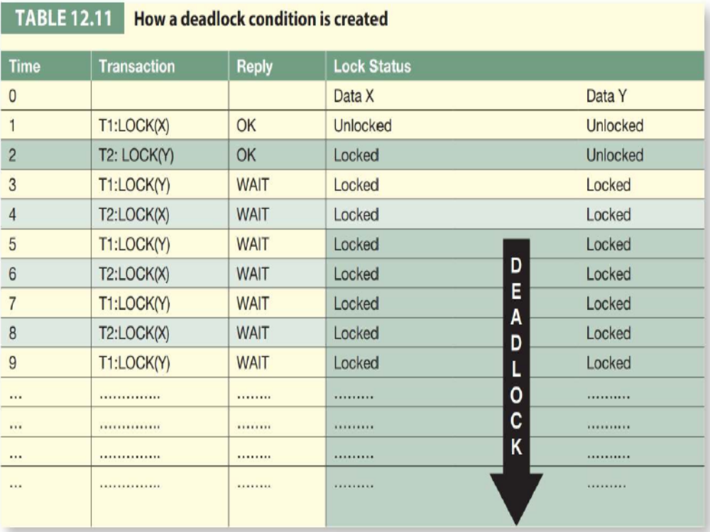

Slide 38
In a real-world DBMS, many more transactions can be executed simultaneously, thereby increasing the probability of generating deadlocks.
Deadlocks are possible only when one of the transactions wants to obtain an exclusive lock on a data item; no deadlock condition can exist among shared locks.

Slide 39
The three basic techniques to control deadlocks are:
Deadlock prevention.
  A transaction requesting a new lock is aborted when there is the possibility that a deadlock can occur.
  If the transaction is aborted, all changes made by this transaction are rolled back and all locks obtained by the transaction are released.
  The transaction is then rescheduled for execution.
  Deadlock prevention works because it avoids the conditions that lead to deadlocking.

Slide 40
Deadlock detection.
  The DBMS periodically tests the database for deadlocks.
  If a deadlock is found, one of the transactions (the victim) is aborted (rolled back and restarted) and the other transaction continues.

Slide 41
Deadlock avoidance.
  The transaction must obtain all of the locks it needs before it can be executed.
  This technique avoids the rollback of conflicting transactions by requiring that locks be obtained in succession.
  However, the serial lock assignment required in deadlock avoidance increases action response times.

Slide 42
The choice of the best deadlock control method depends on the database environment.
For example,
  If the probability of deadlocks is low, deadlock detection is recommended.
  If the probability of deadlocks is high, deadlock prevention is recommended.
  If response time is not high on the systems priority list, deadlock avoidance might be employed.

